Slide 1


Go Fruits!
Team Members: Marisniulkis Lescaille Cos, Pablo Molina, Nersa Doraines Acosta Labrada
Team Name: TutiFruti
Cuba

Slide 2

GoFruits Feature
How to display detailed information of crops in Jamaica
Possibility to connect farmers with buyers and other farmers
Use the information through mobile

Slide 3
GoFruits!
A map shows information Jamaica crops and allows advanced queries
The stakeholders are sellers, farmers interesting to contact with other farmers and any person interesting to consult this information
Application utilise social networking medium and mobile platforms

Slide 4
Intended Revenue Stream
The project will be sustainable by Freemium Subscription.
The application would be released as both a free solution where some features will be exempted and a premium version with all features and a monthly contract on subscribed data.

Slide 5
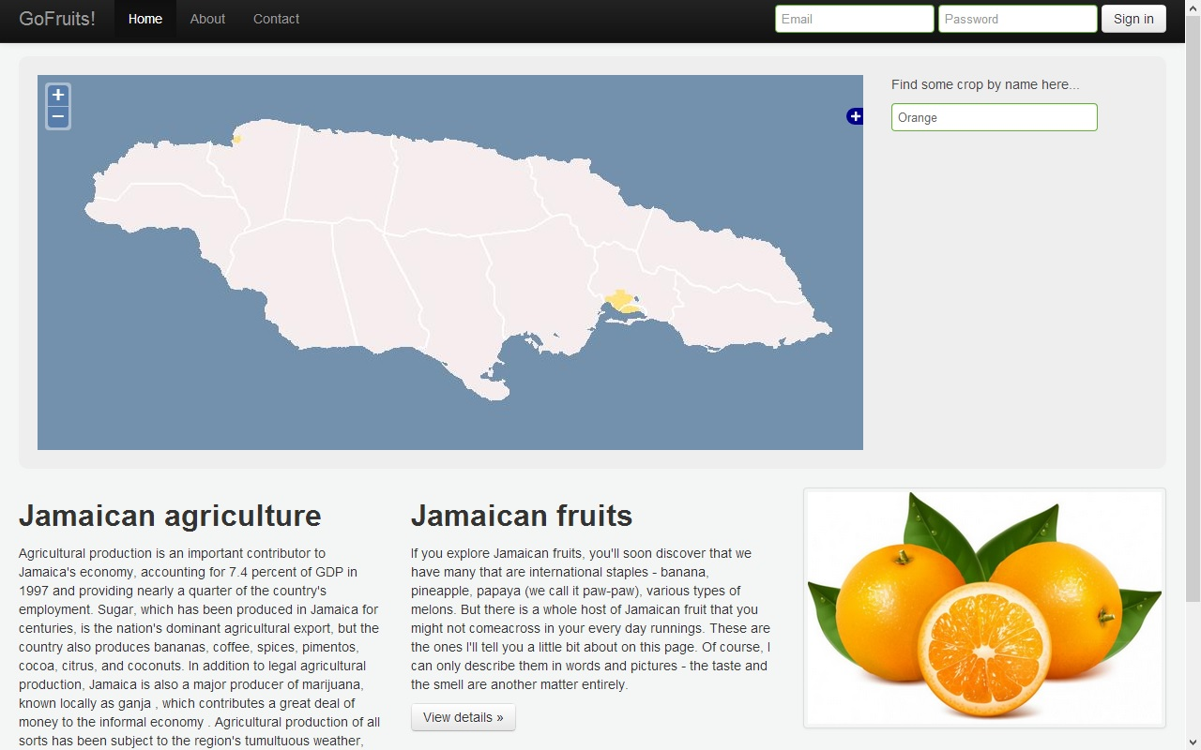

Slide 6
QUESTIONS?

